Slide 1
INSERT LOGO
This CIM Template is provided by ShadowHornet Advisors and is intended for use by companies < $50M in revenue. To learn more about how ShadowHornet can help you source, assess, optimize, and buy or sell a business, visit:
shadowhornet.com
COMPANY NAME
Confidential Information Memorandum
Projected Q1, 2025
Any dissemination of this document, information herein, to entities not covered by a non-disclosure agreement between COMPANY NAME and the entity is strictly prohibited. See DISCLOSURES on the subsequent page for more insight into appropriate and intended use.
© 2024 COMPANY NAME. CONFIDENTIAL. NOT FOR DISTRIBUTION.

Slide 2
DISCLOSURES
COMPANY NAME
This Memorandum has been prepared for informational purposes relating to this transaction upon the express understanding that it will only be used for the purposes set forth above. The Company expressly disclaims any and all liability for the accuracy of the information contained in, or from omissions in, this Memorandum or any other written or oral communication transmitted or made available by the Company, its representatives or any other party involved in discussion. Furthermore, the information contained herein is as of the date hereof, or as of any earlier date described herein. The Company expressly disclaims the obligation to supplement or update any of the information contained in this Memorandum or any other written or oral communication transmitted or made available by the Company, its representatives, any other party involved in discussion. The company has not performed an an independent appraisal of any assets of the Company. No representation or warranty is made with respect to the information contained in this Memorandum and the recipient agrees that it will rely solely on the representations and warranties made to it by the Company in any final agreement.
In furnishing this Memorandum, neither the Company nor party involved in discussions undertakes any obligation to provide the recipient with access to any additional information. This Memorandum shall not be deemed an indication of the state of affairs of the Company nor shall it constitute an indication that there has been no change in the business or affairs of the Company since the date hereof.
All communications, inquiries and requests for information relating to these materials should be addressed to the persons listed herein, as representatives of the Company.
© 2024 COMPANY NAME. CONFIDENTIAL. NOT FOR DISTRIBUTION.
This Private Placement Memorandum (the “Memorandum”) is based on information provided by COMPANY NAME (“COMPANY NAME” or the “Company”). It is being furnished on behalf of the Company to a limited number of parties who may be interested in providing financing to the Company. The sole purpose of this Memorandum is to assist the recipient in deciding whether to proceed with a further investigation of the Company. This Memorandum does not purport to be all-inclusive or to necessarily contain all the information that the recipient may desire in investigating the Company. As a result, each recipient must rely solely on its own due diligence review and analysis of the Company, its business, its financial information, and its future prospects.
This Memorandum contains statements that are forward-looking. These statements are based on current expectations and assumptions that are subject to risks and uncertainties. Actual results could differ materially because of factors discussed throughout the Memorandum. A Confidentiality Agreement previously executed by the recipient of this Memorandum governs this Memorandum and other documents, materials and information relating to the Company.
Unless otherwise provided for in said Confidentiality Agreement, the recipient, by acceptance of this Memorandum, agrees that it will not distribute this Memorandum to others, in whole or in part, at any time without the prior written consent of the Company. The recipient also agrees that all information contained herein, or made available in connection with any further investigation, will be kept confidential in accordance with the Confidentiality Agreement. Upon request, the recipient will promptly return all material received from the Company (including this Memorandum), all in accordance with such Confidentiality Agreement. Any inconsistencies between the terms of this Memorandum and the terms of the Confidentiality Agreement shall be resolved and governed by the terms of the Confidentiality Agreement.
Notes:
AI/Machine Learning
Roadmapping
Enterprise Architecture
Sales and Marketing Enablement

Slide 3
Example: AI and global cost pressures have created an unprecedented opportunity and grave risks for staffing firms and custom software development shops
US tech labor losses over the past 4 years have been India and LATAM’s gains
MARKET PROBLEM DESCRIPTION
Tata Consultancy Services (India) | 2020-Q2 2024
Example: The $218b staffing industry is at a crossroads, exhibiting its first ever decline in 2023. The entrance of AI shifted enterprise budgets from large-scale software projects to AI pilot programs and AI-based infrastructure…
This is an unprecedented opportunity for innovative solutions companies, and a grave risk to those that don’t innovate.
Since 2021, US companies have shifted software development and engineering workloads to low-cost sources like India, APAC/Eastern Europe and more recently, Latin America. They’re also aggressively exploring AI solutions to eliminate US jobs. As a result, the US staffing market is experiencing fierce competition, declining revenue/margins, and industry consolidation.
Success in the future of professional services requires deep industry knowledge, expertise on how to apply AI to specific industries and their challenges, and innovative globally-oriented talent and workforce solutions.
Robert Half Technology
(US) | 2020-Q2 2024
Globant
(Argentina) | 2020-Q2 2024
Notes:
AI/Machine Learning
Roadmapping
Enterprise Architecture
Sales and Marketing Enablement

Slide 4
YOUR MARKET OPPORTUNITY DESCRIPTION WITH HEADLINE Example: fast movers and innovators will quickly take market share from staffing dinosaurs
This moment in the Staffing and Professional consulting services industry is a once-in-a-generation opportunity for forward-thinking, innovative workforce solutions providers to take market share from their slower moving competitors.
By applying deep industry knowledge and technical skills, traditional staffing firms can quickly become trusted advisors - leveraging their strong relationships and sales engines to deliver new services more in line with the future of the market.
This means understanding market and budget drivers in specific industries, understanding how to apply emerging technologies like AI and data solutions to generate value and strategic outcomes through proven frameworks.
Firms that can offer flexible talent solutions through these frameworks have a route to creating new service models, new delivery models, and offerings that embed their firm deeper within their customers.
AI Discovery Framework: enabling customers to determine where to leverage AI most effectively in their business
Train-the-trainer AI go-to-market framework
AI and Workforce training kit: Create a value multiplier effect and sell as a service.
Low Cost Domestic sourcing model and framework: helps companies identify skillset arbitrage opportunities, minimize the risk of culture change, while immediately improving their operating and EBITDA margins
Nearshoring Execution Framework: Enables companies set up business entities and operations in low-cost nearshore locations
Sales and Marketing Opportunity identification tool: helps companies identify the highest leverage opportunities for their marketing and sales budgets
Notes:
AI/Machine Learning
Roadmapping
Enterprise Architecture
Sales and Marketing Enablement

Slide 5
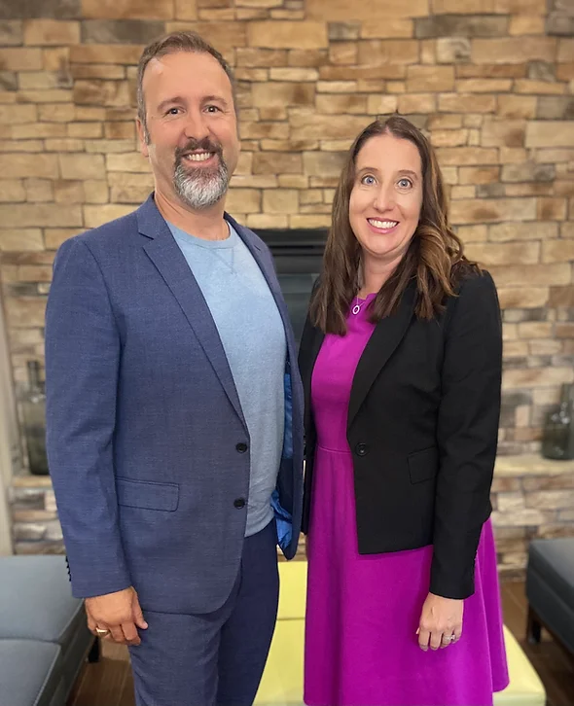
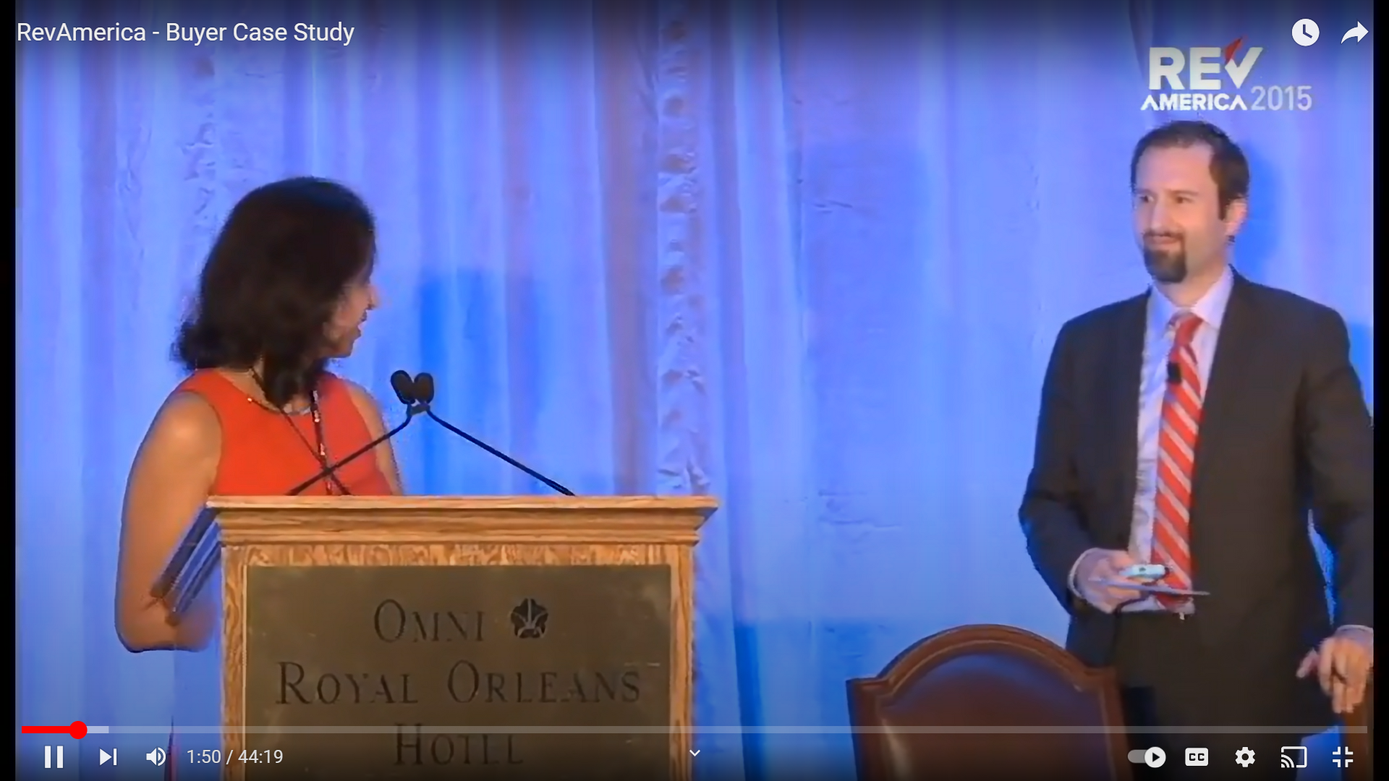
YOUR COMPANY TIMELINE / STORY started with a powerful vision that its founders made into reality over a decade…
2012
2014
2015-16
2016-17
2018-2022
2022
Founders meet when xxx creates Red Hat’s first low-cost domestic sourcing program
Founder outlines a vision of a “Staffing Smart Cloud”
Founder’s efforts nationally recognized, winning a USDA tech workforce development grant
Founder named Workforce Advisor to White House Rural Council
Now executive leaders, xxx collaborate on a refined vision
COMPANY NAME launched as the realization of the talent “smart cloud”
Through his Master’s studies at UNC-Chapel Hill and the USDA grant,
As a EVP/CEO for a…
XXX
Leading the Customer Portal engineering team, "Founder's Name(s)", and domestic sourcing providers in Nebraska to provide quality engineering at 60% of east coast costs
Working on some of the world’s pioneering cloud and AI technology at Red Hat, "Founder's Name(s)" proposes a future vision of “calling up” tech labor resources just like AWS and Azure do with cloud computing.
Named keynote speaker at RevAmerica’s 2015 conference on Domestic Sourcing, "Founder's Name(s)"’s efforts are later featured in CIO Magazine. This led to receiving a USDA grant to study tech reskilling as an economic engine in the rural US.
Notes:
AI/Machine Learning
Roadmapping
Enterprise Architecture
Sales and Marketing Enablement

Slide 6
Introducing COMPANY NAME - Your business concept + Distinct Lines of Business
Example: Trust in the future of technology professional services
COMPANY NAME is a future oriented professional technology services company made for an increasingly global, disrupted, and fragmented labor market. Its three service verticals are structured around our view of the future of technology, AI, and labor in 5 market verticals.
Healthcare
Buy and Sell Side M&A Services
Deal Sourcing and Pipeline mgmt Competitive Market Intel and Strategy
Due Diligence
M&A Integration
EBITDA recovery services
Nearshore
Offshore
outsourcing + AI-based automation
Operational Efficiency and Scaling Solutions
Utilities, energy and telecom
Financial Services
High Tech + retail supply chain
FED / SLED
COMPANY NAME combines top industry talent with top technical talent to create value for our customers faster and more cost effectively. We serve as our customers guide through uncertainty and the incessant storm of radical technology innovation.
Notes:
AI/Machine Learning
Roadmapping
Enterprise Architecture
Sales and Marketing Enablement

Slide 7
Introducing COMPANY NAME - Competitive Advantage and Favorable market positioning
Trust in the future of technology professional services
COMPANY NAMEdelivers its services to the market under two distinct brands:
Vertical strategic consulting and applied technology
Nearshore / Offshore outsourcing + AI-based automation and EBITDA recovery
Fractional Workforce Solutions
Notes:
AI/Machine Learning
Roadmapping
Enterprise Architecture
Sales and Marketing Enablement

Slide 8
COMPANY NAME - Competitive Advantage and Favorable market positioning + market education
EX: World-class technical solutions and world-class talent supplied with flexible engagement models – enabling customers to achieve ROI at any budget level…
In a world where traditional FTE, contract, and staffing solutions are being disrupted and labor budgets becoming more competitive, COMPANY NAME enhances traditional staffing solutions. By providing C-level strategy paired with flexible team-based execution, innovative frameworks, global reach, and leading subject matter experts, COMPANY NAME advances its customers into the future of technology solutions.
Strategic Insight
Our executive level
industry experts speak the strategic language of buyers in our core verticals.
We move faster, with more client confidence
Our frameworks enable value delivery from Day 1
Our immediate credibility starts sales account expansion from Day 1
Collaborative data-driven goal setting maximizes our reach and face-time with influential buyer executives.
Execution Discipline
Our industry leading technical and technology adoption experts become “in the trenches” partners to ensure ROI and outcome-based success.
Nearshore / Offshore low cost delivery
AI-based automation and EBITDA recovery
World-class fractional solutions
Organizational change management mastery and coaching
Maniacal focus on ROI
We ensure our clients ROI through our ethical dealing and focus on value.
Our exceptional expertise and technical skill coupled with our flexible fractional engagement models enable us to precisely control costs and deliver faster.
We enter every customer relationship intending to be a long-term trusted advisor.
Notes:
AI/Machine Learning
Roadmapping
Nearshore / Offshore outsourcing + AI-based automation and EBITDA recovery
World class Fractional solutions
Collaborative, data-driven goal setting
Educate sales staff - Enablement planning
Change management
Communications strategy
Coaching, training
Enterprise Architecture
Sales and Marketing Enablement

Slide 9
LEADERSHIP OVERVIEW:
Example: Experienced, diverse, high-caliber
EXAMPLE: COMPANY NAME combines McKinsey consulting expertise, White House Advisory and Eliassen staffing experience with business leadership that has led 12 M&A business exits ($48.6 billion in deal value), 80 technology outsourcing engagements, and held executive roles in utilities and telecommunications, healthcare, financial services, and high tech verticals. Our leaders served in leadership positions at Red Hat, McKinsey, and Eliassen Group for a combined 21 years in software engineering, operations, marketing, sales and sales enablement.
"Founder's Name(s)"
"Founder's Name(s)"
"Founder's Name(s)"
*
*
*
PHOTO
Experience bullet highlights
PHOTO
PHOTO
Experience bullet highlights
Experience bullet highlights
Years of Professional Experience
Prior Leadership Experience
Education
Years of Professional Experience
Prior Leadership Experience
Education
Years of Professional Experience
Prior Leadership Experience
Education
Company Logos
Company Logos
Company Logos
Notes:
AI/Machine Learning
Roadmapping
Enterprise Architecture
Sales and Marketing Enablement

Slide 10
Plain speak - why you’re different and better than the rest + Your Management Philosophy/Values
Consulting costs too much. Staffing leaves opportunity on the table.
Consultants don’t get their hands dirty and can charge over $400/hr for slides and meetings, leaving the dirty work to the customer.
Staffing providers can find the talent, but can they understand what’s driving industry strategy and apply advanced solutions to achieve ROI? Just finding and supplying talent isn’t much of a competitive differentiator in today’s market.
COMPANY NAME blends the best of staffing and consulting with flexible engagement models that guarantee customer ROI. This makes us faster and more influential than the majority of staffing firms, and more affordable and effective than most consultants. We’re our customers trusted advisors to the increasingly complex business landscape.
We have C-Level executive talent in 5 industry verticals who can engage with the CEO, COO, CTO, CIO on their level, speaking their language because we’ve walked in their shoes.
We have advanced global technologists who can apply technology to solve complex industry problems.
We don’t have just AI experts - we have applied AI experts in your industry vertical, who have already solved your problems.
We blend both executive strategy and applied technology - and offer access to our services through any buyer vehicle SOW, fractional, traditional contracting, enabling us to move faster, deliver ROI from day 1, and expand accounts from point-of-entry to the C-Level quickly.
We Know Nearshore Like No One Else
Executive Level Industry Experts
+
Industry Leading Technical Experts
+
Focus on your goals and budget
X
Ethical Dealing
_______________Exceptional ROI
Notes:
AI/Machine Learning
Roadmapping
Nearshore / Offshore outsourcing + AI-based automation and EBITDA recovery
World class Fractional solutions
Collaborative, data-driven goal setting
Educate sales staff - Enablement planning
Change management
Communications strategy
Coaching, training
Enterprise Architecture
Sales and Marketing Enablement

Slide 11
LINES OF BUSINESS DESCRIPTIONS + MARKET EDUCATION IN EASILY EXPLAINED GRAPHICS
Example: offering customers flexibility and maximizing their ROI
Executive Strategic Expertise
+
Fractional Applied Technology Experts
Delivered Any way the Buyer Wants
Healthcare
Utilities, energy and telecom
Over 120 high caliber fractional, global technologists, business experts and doers with impeccable ethics and track records
FED / SLED
Financial Services
High Tech + retail supply chain
Notes:
AI/Machine Learning
Roadmapping
Enterprise Architecture
Sales and Marketing Enablement

Slide 12
MARKET INFORMATION - EDUCATE THE INVESTOR ABOUT HOW YOUR SOLUTION SERVES THE ATTRACTIVE MARKET
A Global 1099 Network Optimized for Value Delivery
COMPANY NAME is structured to deploy rapid ROI to customers by using its global network of highly qualified 1099 contractors and its versatile leadership team. This enables the firm to make cost effective, competitive proposals, and deliver value ahead of schedule while it avoids most fixed costs associated with staffing and consulting firms.
COMPANY NAME’s network offers senior and mid-senior level expertise in healthcare, utilities and telecom, energy, retail and supply chain, and high tech verticals, combined with experts in:
Artificial intelligence and machine learning
DevOps and enterprise/solution architecture/sales engineering
Network architecture and cyber security
Geospatial applications
Marketing analytics
Sales enablement and prospecting
M&A, scaling, and valuation
Augmented reality
Over 120 high caliber fractional technologists, business experts and doers with impeccable ethics
Notes:
AI/Machine Learning
Roadmapping
Enterprise Architecture
Sales and Marketing Enablement

Slide 13
QUANTIFY THE OPPORTUNITY = MARKET EDUCATION AND HOW YOUR SOLUTION SERVES THE MARKET. USE DATA IF POSSIBLE DETAILING Total Addressible Market (TAM), Serviceable Addressible Market (SAM), Serviceable Obtainable Market (SOM)
Repositioning a staffing firm as an innovative and credible thought leader on the future of workforce trends in today’s noisy market trends requires multiple types of marketing efforts.
COMPANY NAME has developed several media and AI vehicles that can be immediately leveraged to draw attention, engage prospects, and break through the noise in the marketplace.
$218B
TAM
Staffing and Workforce Solutions Market
$106B
SAM
Fractional Solutions
$10B
SOM
Accessible through channel and direct
5YR Target 1.2% market share
Notes:
John: maybe treat as product slide? Breakout?
AI/Machine Learning
Roadmapping
Enterprise Architecture
Sales and Marketing Enablement

Slide 14
SUMMARY - PROBLEM + PAIN POINTS + YOUR SOLUTION
Industry Problem:
Declining growth forecasts
Opportunities are more complex than ever
Current staffing solutions aren’t flexible enough to meet the pace and unpredictability of the increasingly global market
COMPANY NAME built its business around “where the puck is going” in the labor market over the next decade. With less operating budget available for tech labor, high and rising US labor costs, and capital expenditure shifting away from large software projects to the AI and automation ecosystem, US staffing firms need to create value faster and more economically than ever.
This means partnering with workforce solutions firms that can offer much more than “finding the right people”. US companies are becoming more demanding, and more precise in the problems they need to solve.
COMPANY NAME gives firms a flexible range of options that are highly differentiated from traditional staffing, professional services, and consultancies – all at costs that are affordable – generating guaranteed ROI, and defending ROI, without the risks associated with traditional staffing.
Specific Pain Points:
US labor costs are too high and worker turnover creates high risks
Stagnant budgets make “Big 4” consulting unaffordable, less likely to use staffing firms
Current VMS, procurement, and hiring solutions block companies from moving fast enough.
COMPANY NAME’s Differentiation
Flexible talent solutions
Top of market technical and business capabilities
Accessible ON DEMAND, enabling companies to control costs, boost margins, generate immediate ROI
We’re a “staffing smart cloud” geared toward the future of talent acquisition in our 5 industry verticals
Notes:
AI/Machine Learning
Roadmapping
Enterprise Architecture
Sales and Marketing Enablement

Slide 15
WHY YOUR LINES OF BUSINESS MAKE SENSE AS THE SOLUTION
COMPANY NAME’s Differentiation
Offers highest level consulting capabilities at 50% of the cost in 5 verticals.
Options to access high-performing talent at a fraction of the cost of FTE and contract solutions - enabling fast results with spend control.
Fractional talent solutions
Global solutions: Nearshore / Offshore/ Blended Teams
AI and data experts
We give you impossible to find AI/ML, DevOps, Data architecture expertise quickly. We provide it, on demand, with proven frameworks - WITHOUT the cost of maintaining a bench. We’re a trusted guide to our customers.
Full lifecycle nearshore/offshore solutions
Industry Problem:
Declining growth forecasts and budgets in most industries pressure operating margins.
Emerging growth opportunities are highly complex requiring specialized industry knowledge and technical aptitude.
Staffing environment is highly unpredictable, rapidly changing, and more competitive than ever.
AI offers high potential but is too complex to apply today to real business challenges.
Specific Pain Points:
US labor costs are too high and worker turnover creates high risks and delays - pushing firms to look outside US
Stagnant budgets make “Big 4” consulting unaffordable, less likely to use staffing firms
Current VMS, procurement, and hiring solutions block companies from moving fast enough.
Companies need a guide to understand how to apply AI to their business, profitably
Notes:
AI/Machine Learning
Roadmapping
Enterprise Architecture
Sales and Marketing Enablement

Slide 16
Financial Highlights
FINANCIAL RESULTS + PROJECTIONS SUMMARIZED BY YEAR AND QUARTER
In the toughest tech market in 20 years, COMPANY NAME exhibited an average YoY xxx% top line growth rate
COMPANY NAME’s growth suggests a strong alignment between its future oriented talent solutions and current buyer demand
COMPANY NAME’s
COMPANY NAME
FINANCIAL RESULTS + PROJECTIONS SUMMARIZED BY YEAR AND QUARTER
Notes:
AI/Machine Learning
Roadmapping
Enterprise Architecture
Sales and Marketing Enablement

Slide 17
Financial Highlights
FINANCIAL RESULTS + PROJECTIONS SUMMARIZED BY YEAR AND QUARTER
Summarized strengths
Weaknesses acknowledged
Head off any specific questions from the pattern of the financials here
OPTIMISTIC PROJECTIONS BALANCED WITH REALISTIC ASSESSMENTS (aggressive, base, conservative forecasts)
Notes:
AI/Machine Learning
Roadmapping
Enterprise Architecture
Sales and Marketing Enablement

Slide 18
FINANCIAL Business Asset Overview
Balance Sheet Overview
Make it simple
Real assets
Intangiable assets
Competitive Moats/Barriers?
Strategic Partnerships + Exit Buyers?
Notes:
AI/Machine Learning
Roadmapping
Enterprise Architecture
Sales and Marketing Enablement

Slide 19
SALES OVERVIEW: Weighted Sales Pipeline or Revenue Commitments
Sources of revenue with justification (if projections)
Sales pipeline with LCV (if B2B)
Notes:
AI/Machine Learning
Roadmapping
Enterprise Architecture
Sales and Marketing Enablement

Slide 20
SALES OVERVIEW: EXISTING TEAM, WHY IT’S POSITIONED TO SUCCEED. WHAT NEW FUNDING WILL ENABLE
Team overview. Honest acknowledgement of strengths, weaknesses, opportunities and threats.
Highlights of sales performance. Any major wins, pipeline deals, strategic opportunities or developments.
Notes:
AI/Machine Learning
Roadmapping
Enterprise Architecture
Sales and Marketing Enablement

Slide 21
Client Overview / Strategic Partnership Overview
Healthcare
Utilities, Energy and telecom
Financial Services
High Tech / Retail Supply Chain
FED / SLED
Notes:
AI/Machine Learning
Roadmapping
Enterprise Architecture
Sales and Marketing Enablement

Slide 22
PRODUCT/SOLUTIONS = Revenue sources by LOB AND CLIENT
COMPANY NAME’s customer base is well diversified between large publicly traded firms, mid-market, and the lower mid-market
> $3 Billion (Annual)
$1-3 Billion (Annual)
$500M - $1B (Annual)
$100 - 500M (Annual)
$30 - 100M (Annual)
< $30M (Annual)
Notes:
AI/Machine Learning
Roadmapping
Enterprise Architecture
Sales and Marketing Enablement

Slide 23
PRODUCT Overview
1-3 slides max demonstrating your key products and services. List them in order of current revenue, and/or future revenue potential. Now is the time to fully explain the product’s positioning in the market, importance to your strategy, and future outlook. Highlight potential, but also be realistic.
Buying firms are used to hearing “the sky’s the limit”, but know that 90% of deals fail to meet the expectations set in the diligence process, so they are highly skeptical. Aim to highlight the range and value of the product portfolio, and use this as an opportunity to highlight assets that are important, but that you might not market effectively today.

Slide 24
Operations Overview
Paint the picture of how the initial leadership and management team will evolve to improve EBITDA and scalability over the short/intermediate and long term.
Do your best to paint the picture that your processes are well implemented and documented. These slides are vital to demonstrating that you have command of your operations, and can achieve 2 things:
EBITDA improvements post-acquisition. Your command of operations means that you can deliver more under a reduced cost structure.
Faster and lower cost integration. Because you have a handle on operations, you’ll be able to adapt and evolve into the buyer’s operating model. In fact, you may serve as a model for their operations.
This slide is important, because it’s where a seller can start planting seeds that result in managerial and negotiating leverage with the buyer.

Slide 25
PERSONNEL Overview
ORG CHART IF POSSIBLE. This is important because many companies struggle to fully disclose their personnel early in the due diligence process, raising questions and red flags. Proactively providing an org chart demonstrates that you’re serious, organized, and aware of the importance of having command of this information.
Note that personnel charts are easy to obtain for educated buyers through several technology solutions, even before you reveal any data…if you don’t reveal now, you’re already losing leverage in the process.

Slide 26
Future Vision With Strong Close
Paint your picture of the serviceable addressable market - what can you reach from this investment? How big can it go?
Link your prior slide (Operations overview) to this vision. Your people/expertise/etc. Are key to unlocking this vision…
Aim to “activate the investor’s enthusiasm”.
Aim for the entire presentation to be around 25 slides, no more than 30. Effective CIMs can be as few as 16 pages, and give the prospective investor/buyer enough information to get them interested and potentially excited, but leave enough questions to want them to come back. Be careful. As you paint an optimistic picture, don’t stretch too far – you’ll lose credibility. Buyers are notoriously good at detecting “puffery” (aka “B.S.”) in the CIM. But don’t undersell your firm’s value.

Slide 27
Any questions? We’re here for you. We’ve helped 27 clients expand, finance, and sell their businesses. Let’s collaborate on solving your toughest problems today!
Buy and Sell Side M&A Services
EBITDA recovery and valuation enhancement
Operational Efficiency and Scaling Solutions
We Help Business Buyers and Sellers Achieve More
Visit ShadowHornet.com now to learn more!
Or email: info@shadowhornet.com
ShadowHornet’s outcome and execution focus leads to exceptional results
Notes:
Shift your technology workload to a more manageable cost structure through outsourcing
Scale through growth with a compelling product and technology vision to improve your valuation
Find a strategic buyer
Rapidly modernize a legacy product offering to invigorate growth pr prepare for strategic exit
Develop new product offerings and go-to-market, globally
Take your non-US business into the US market
Streamline your business to improve EBITDA margins or operating margins
Or just need part-time executive advisory and help for Chief Product, Chief Technology, or Chief Information Officer roles

Slide 28
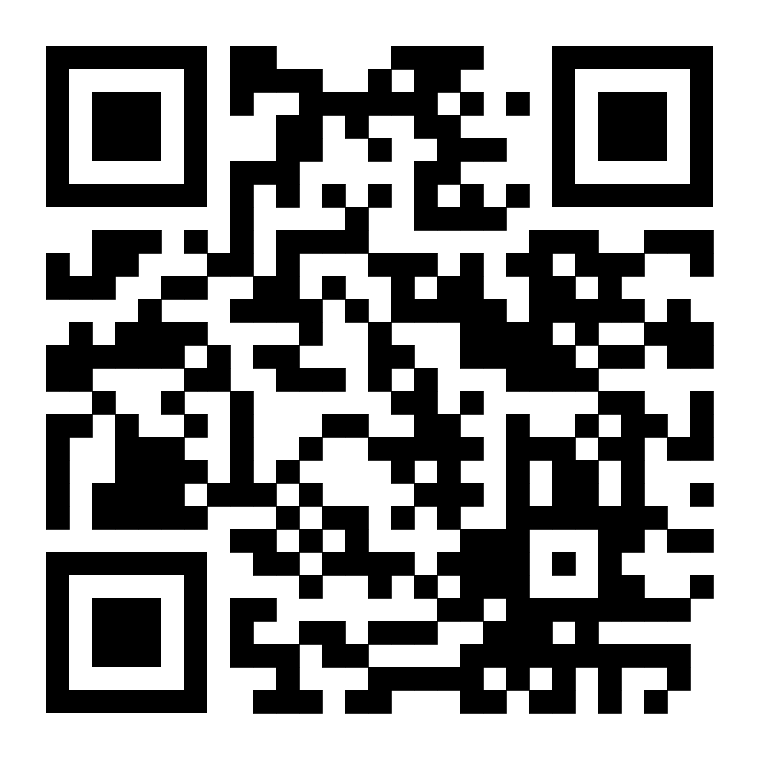
Got M&A?
Buy and Sell Side M&A Services
EBITDA recovery and valuation enhancement
Operational efficiency and scaling solutions
For strategic and financial buyers, and lower mid market sellers who want more…
We Help Business Buyers and Sellers Achieve More

Slide 29
M&A Sourcing, Integration, Optimization, and Exits
We Help Business Buyers and Sellers Achieve More
M&A, scale up, and EBITDA recovery services for strategic and financial buyers, and lower mid market business sellers
Deep Vertical Expertise in: shadowhornet.com
Financial Services | Healthcare | Telecom/Energy/Utilities | Tech Services info@shadowhornet.com
ShadowHornet.com

